Slide 1
"VISION IMPAIRED WEARABLE MOVEMENT ASSISTANT USING ECHO LOCATION"

Slide 2
GROUP MEMBERS
MOIN SHAHRIYAR - 1610586042
SARHAN OSMAN BHUIYA - 1611008042
FARJANA ALAM - 1620060042

Slide 3
BACKGROUND
Our goal is to develop an object detecting device for the visually impaired people
With the help of the device blind people can avoid collision
Through our device we want the visually impaired people to increase their ability to interact with their surrounding world

Slide 4
COMPONENTS
SONAR SENSORS
VIBRATION MOTORS
ARDUINO
8266 WIFI MODULE
POWER SUPPLY
WIRES
BREAD BOARD

Slide 5
APPLICATIONS
Determining obstacles around the user body from the ground to the head
Providing information about the distance between the user and the obstacle with essential vibrating intensity
Affording information to give the ability of self-orientation and mental map of the surroundings
Providing mobility instructions and paths to guide the user and develop her/his brain about the environment.
Google navigation to a specific address or location by using headphones

Slide 6
BLOCK DIAGRAM
Power Supply
Sonar Sensor
Arduino UNO
Vibration Motor
ESP8266
User
IFTTT Server
Google Assistant

Slide 7
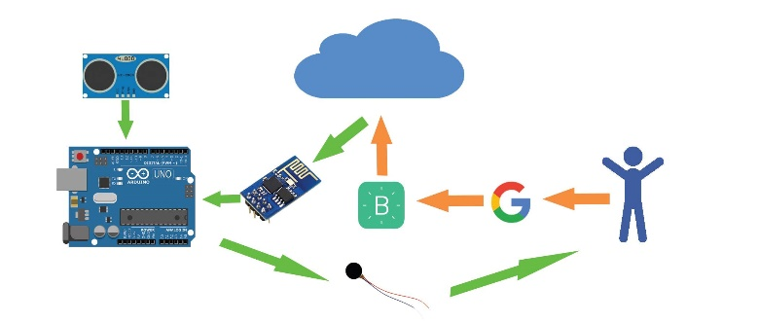
METHODOLOGY

Slide 8
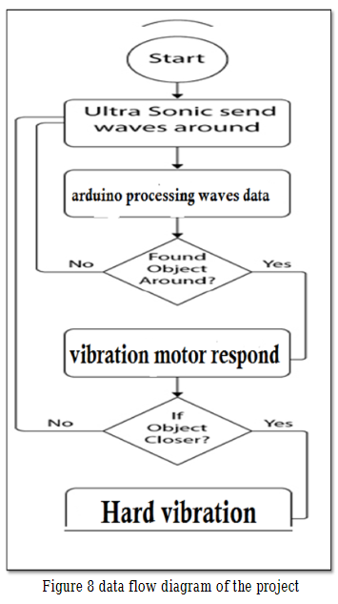
WORKING
PRINCIPLE

Slide 9
RESULTS
OBSTACLE | TEST
FROM 2 cm to 10 cm | HARD VIBRATION
FROM 10 cm to 20 cm | MEDIUM VIBRATION
FROM 20 cm to 30 cm | LOW VIBRATION
ABOVE 30 cm | NO VIBRATION

Slide 10
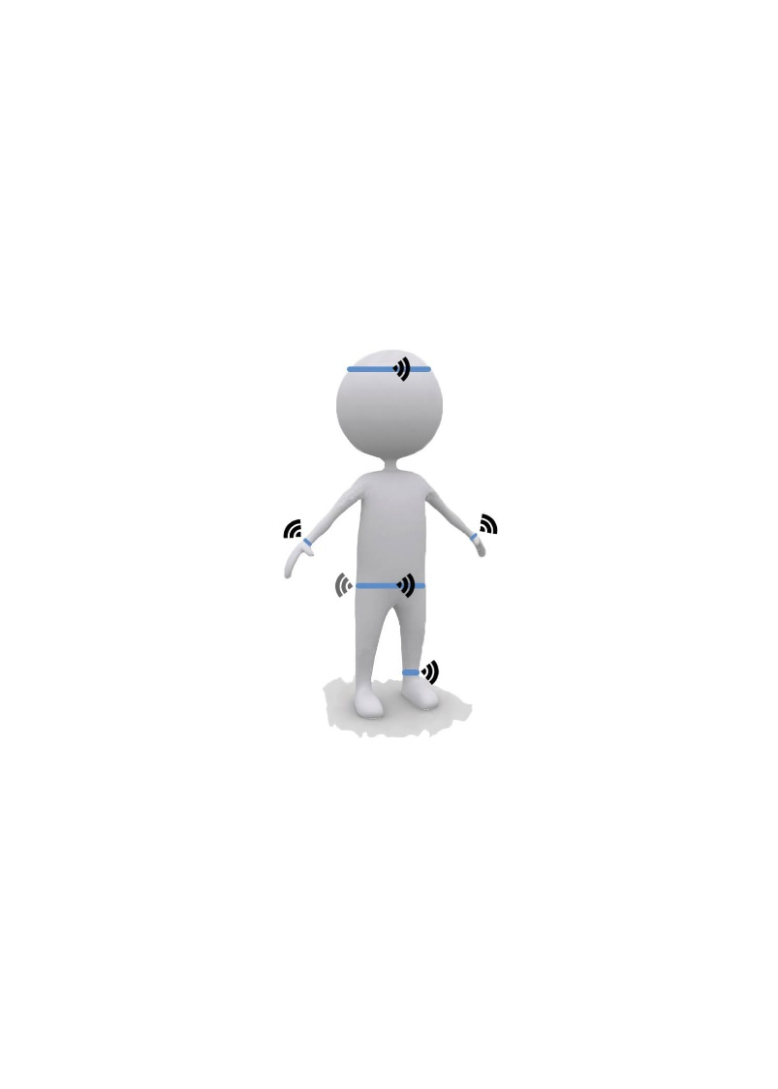
DEMONSTRATION
6 sonar sensors will be attached to the blind user’s body as shown below:

Slide 11
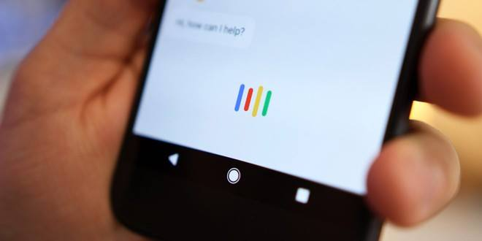
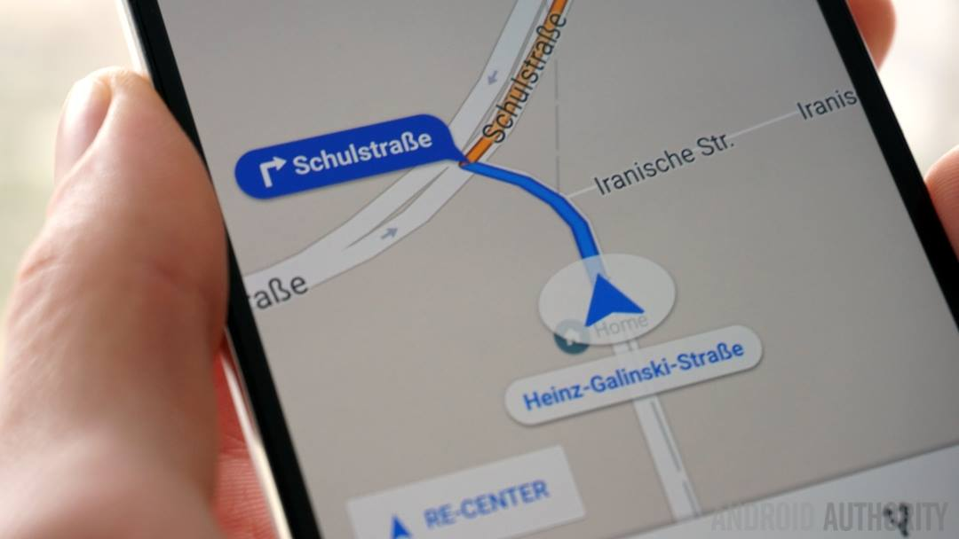
GOOGLE ASSISTANCE AND
GOOGLE NAVIGATION

Slide 12
FUTURE CHALLENGES
Our device has to be user friendly for those who is visually impaired. Firstly the system needs to provide a fast processing for the exchanged information between the user and sensors.
To operate the device visually impaired people need some practice to understand the distance of any obstacles through the intensity of vibration.
In our future implementation we will connect our device with the GPS so that visually impaired people can set their destination and detect current location through their voice command so that it will be very easy to operate and set automated for different users.

Slide 13
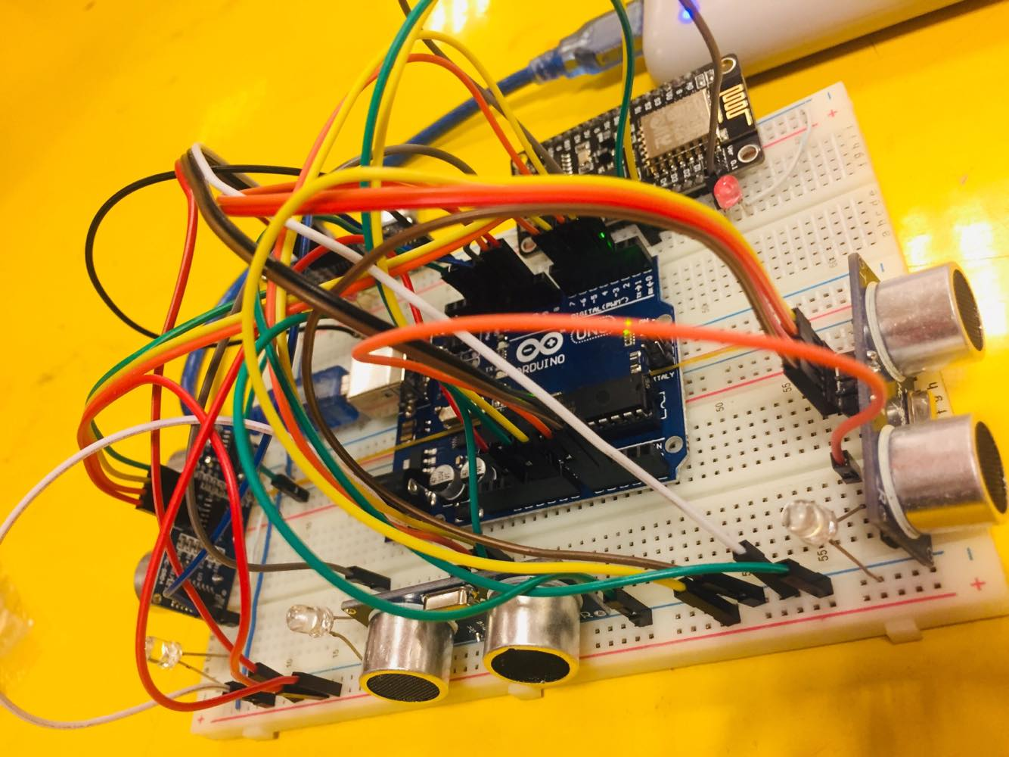
ANY QUESTIONS?

Slide 14
THANK YOU

